Slide 1
Azure Cosmos DB as Vector Database
Michael John Peña
Microsoft MVP: Azure
Data and AI Director @ Playtime Solutions

Slide 2
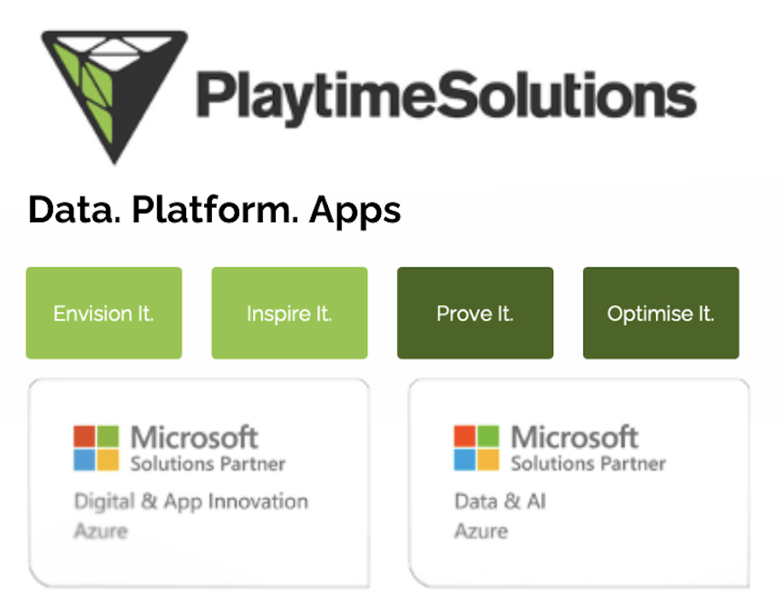

Student Ambassador (MSP) ~ 2010
Consulting (App Dev) ~ 2012
Microsoft MVP ~ 2016
Startup (Data & AI) ~ 2019
ISV (Platform) ~ 2020
Consulting (Data & AI) ~ 2022
MCP & MCT ~ 2023

Slide 3
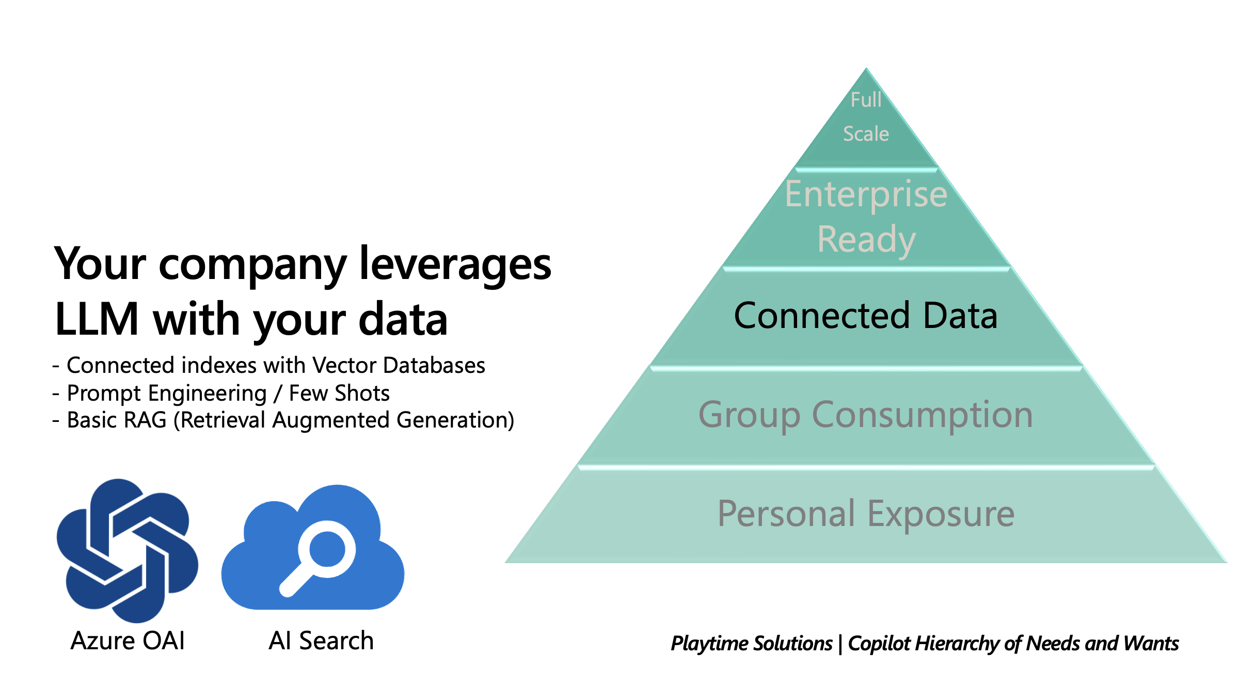

Slide 4
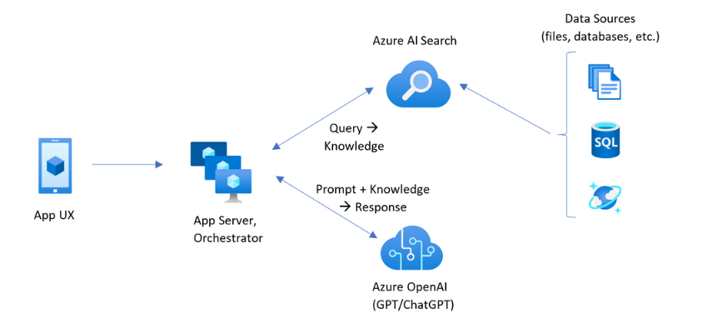

Slide 5








Vector Database on Azure
Hosted (Native)
Search
No-SQL
SQL

Slide 6
Vector Database Option on Azure Cosmos DB
Azure AI Search via Indexer (no-code)
MongoDB Core
Postgres (Citus and PgVector)

Slide 7
AI Search

Slide 8
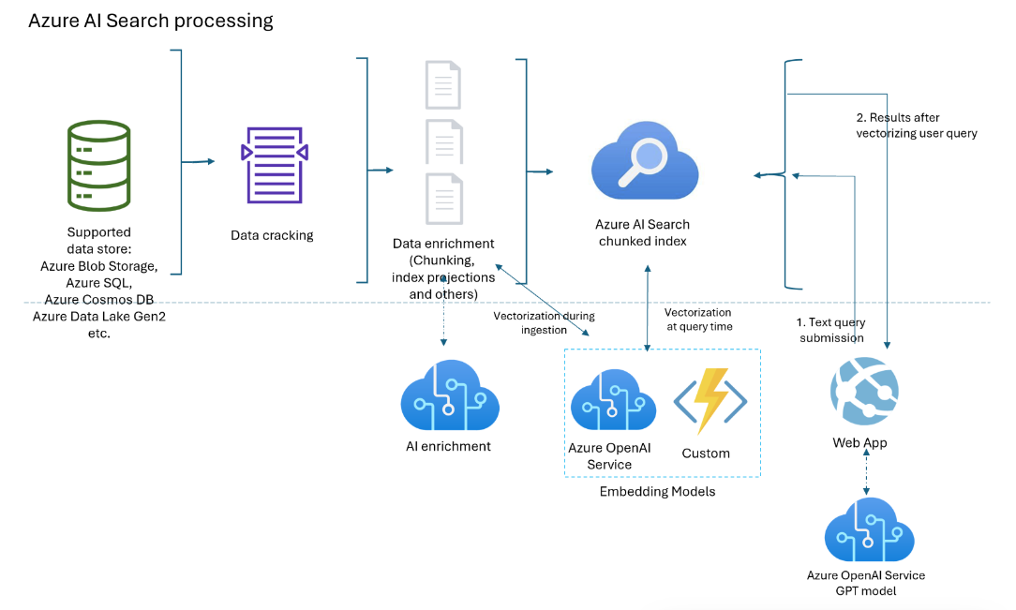

Slide 9
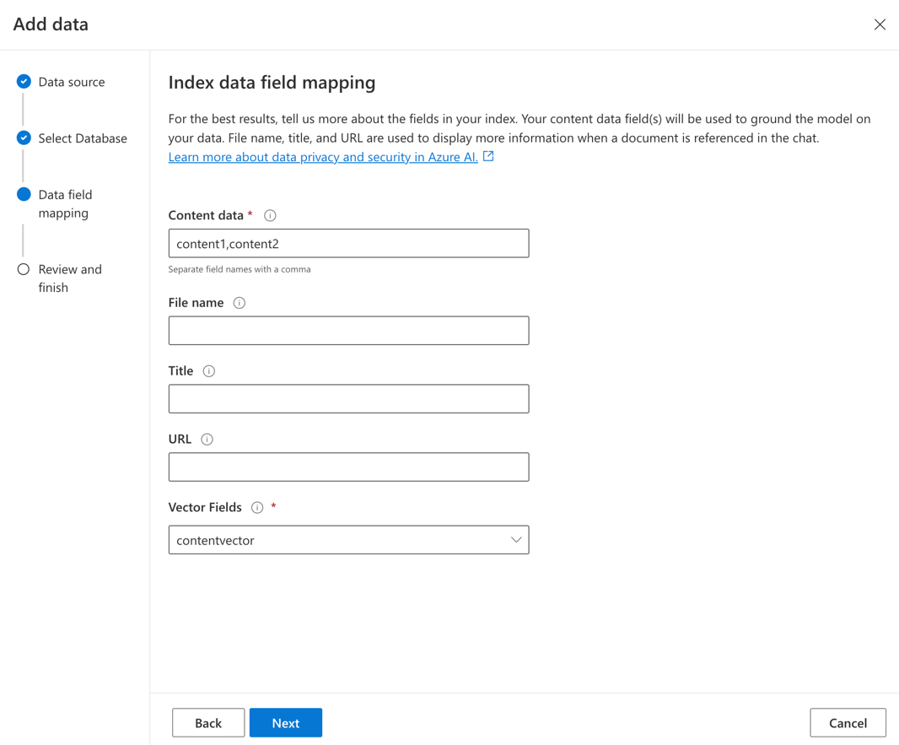

Slide 10
MongoDB Core

Slide 11
Postgres

Slide 12
Thank you!
https://github.com/mjtpena/azcosmosdbconf
https://learn.microsoft.com/en-us/azure/cosmos-db/vector-database
https://github.com/pgvector/pgvector
Learn More
Michael.Pena@playtimesolutions.com.au
LinkedIn

